Slide 1


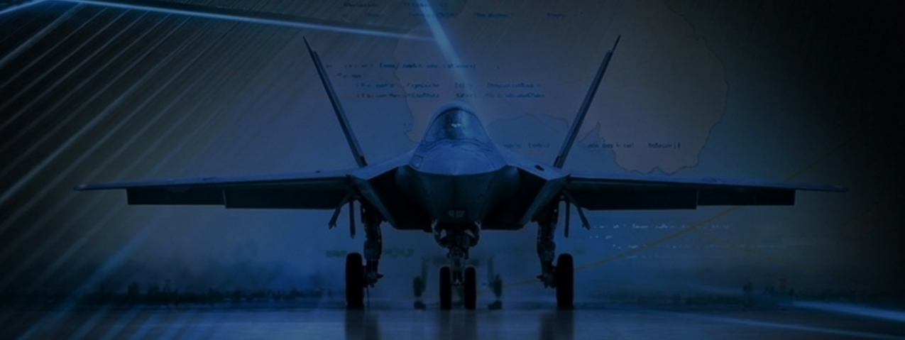
Air Force Doctrine 2035
“Victory smiles upon those who anticipate the changes in the character of war, not upon those who wait to adapt themselves after the changes occur.
- Giulio Douhet

Slide 2
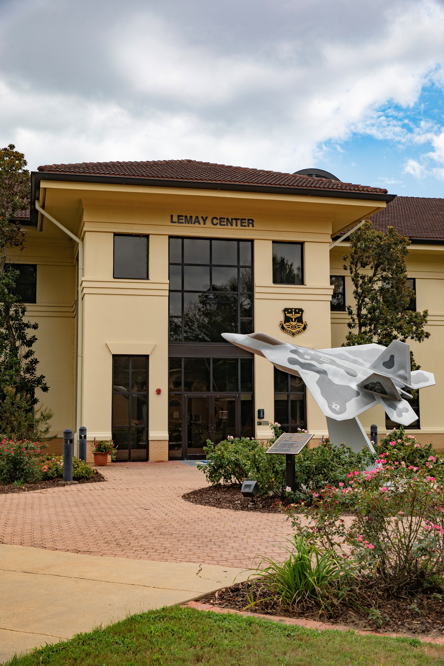
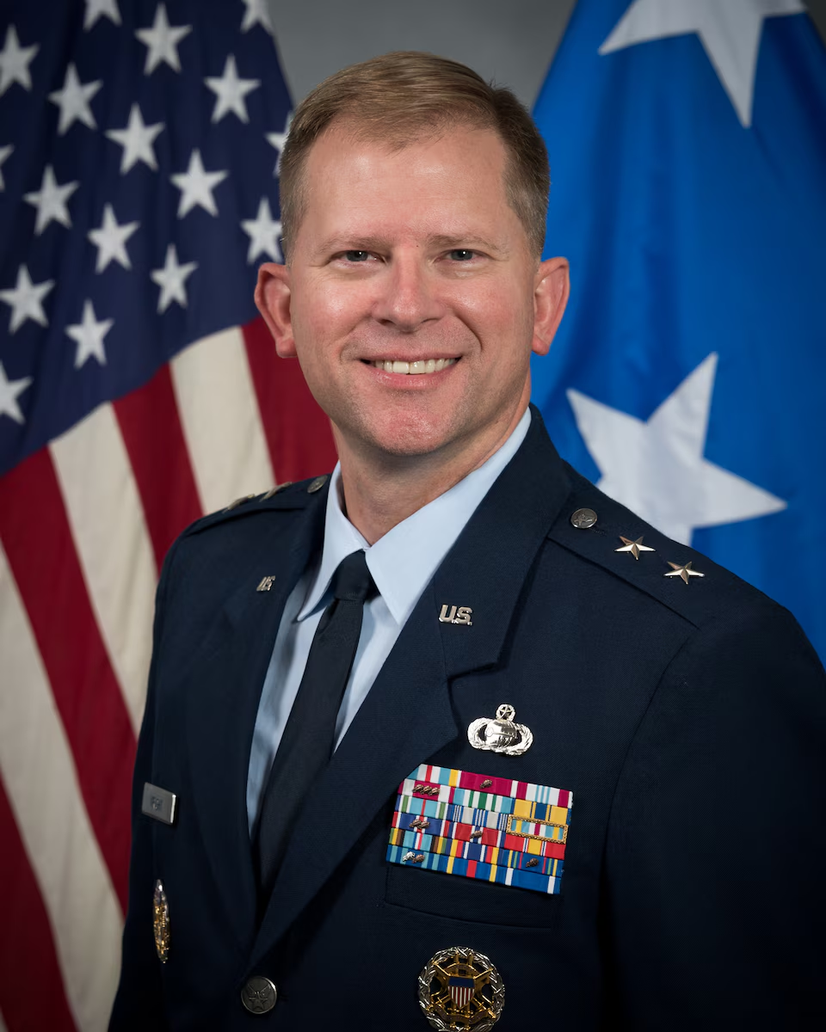

Air Force Doctrine 2035
COMMANDER’S WELCOME
Major General Parker H. Wright
Commander
Curtis E. LeMay Center for Doctrine Development and Education

Slide 3


“Progress Unhindered by Custom”

Slide 4
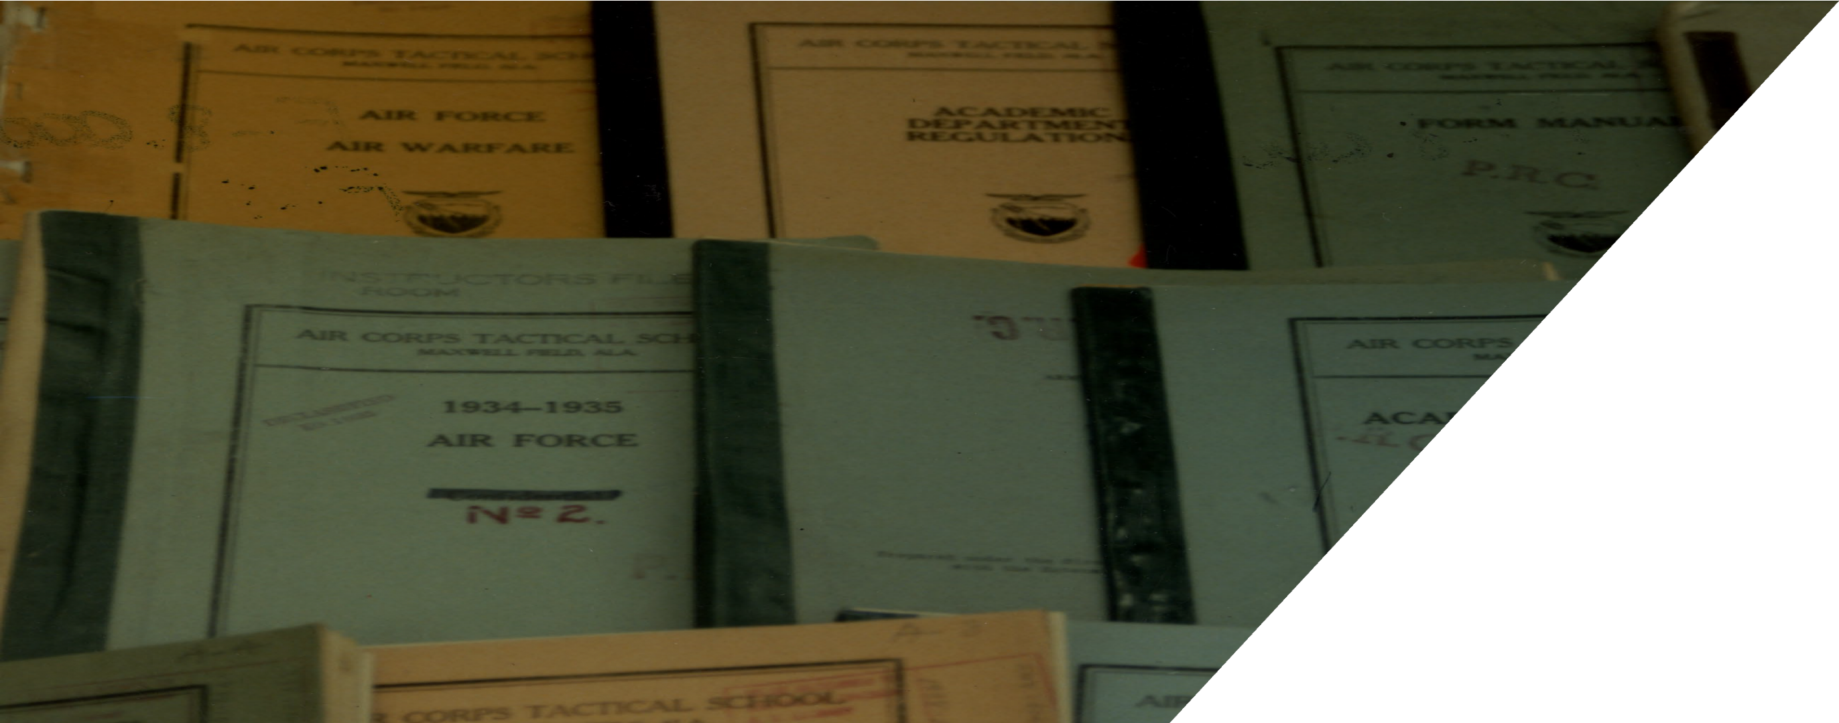
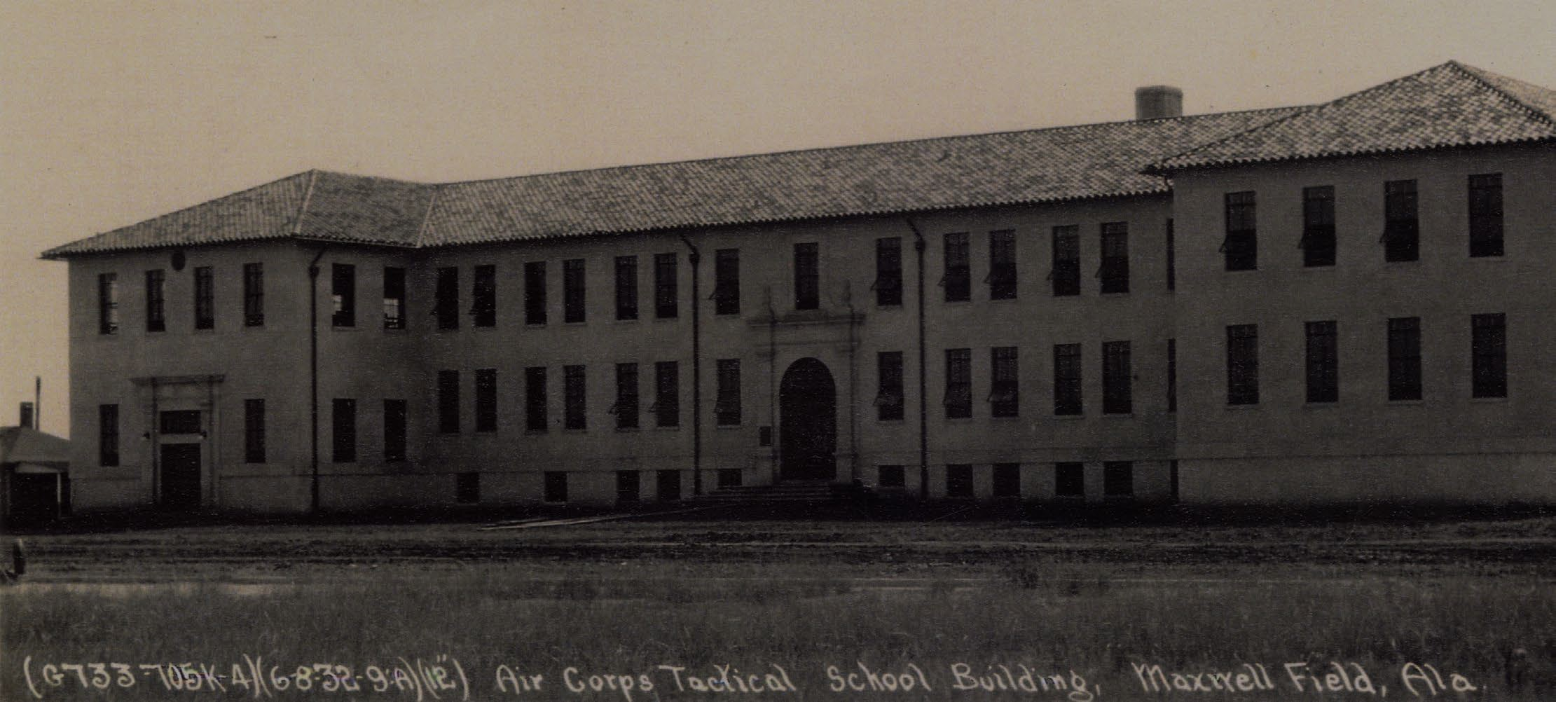



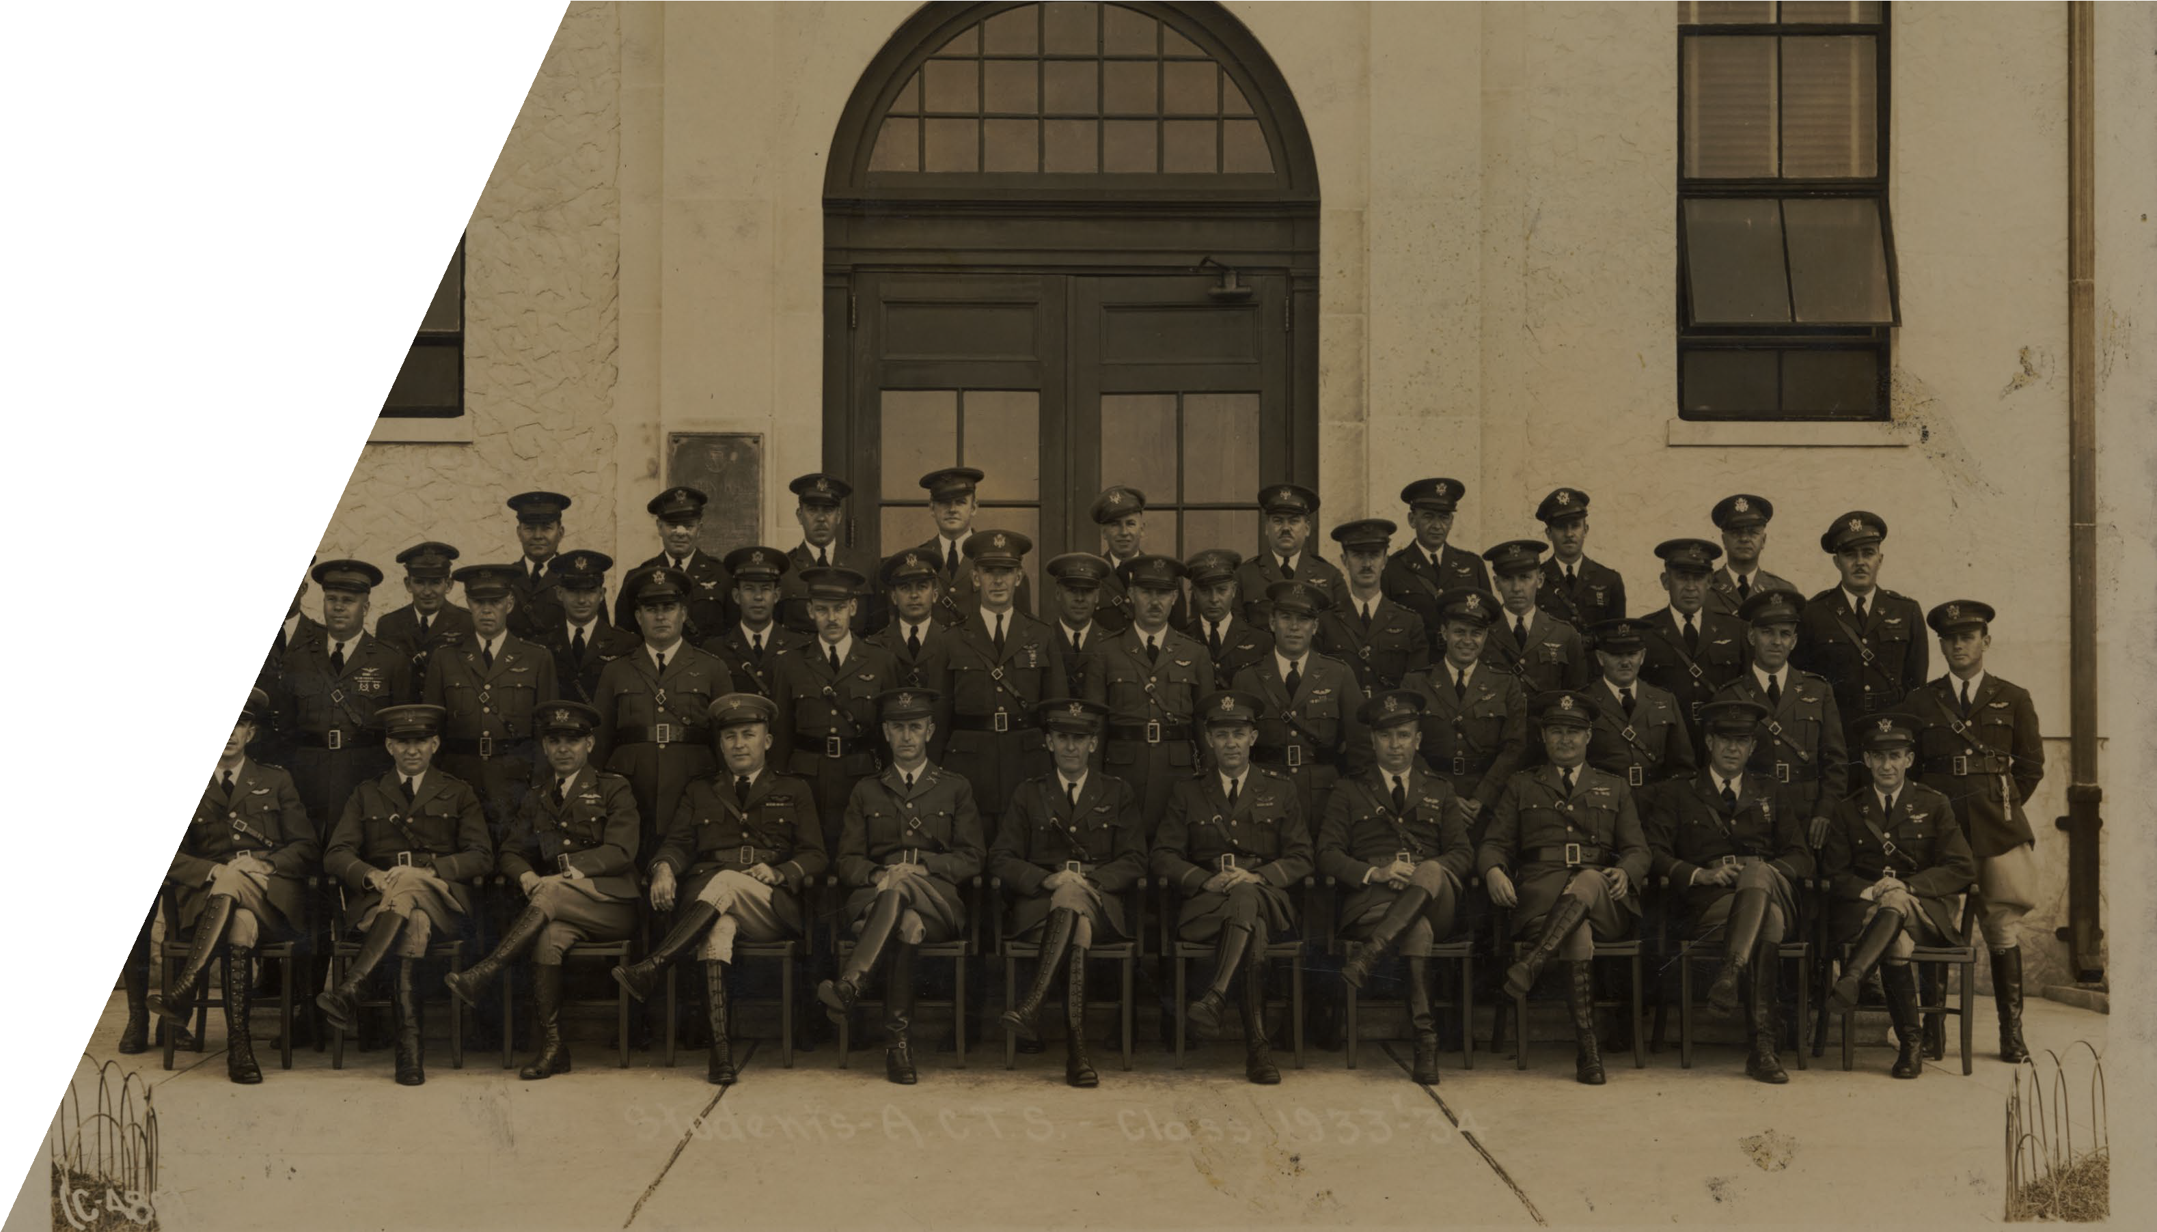

UNCLASSIFIED

Slide 5
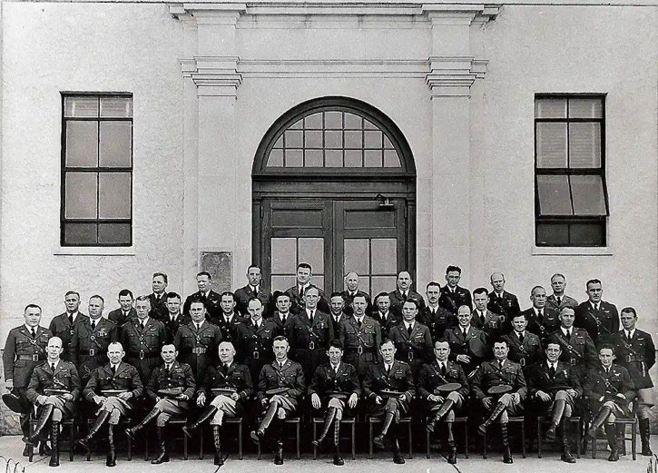
The Air Corps Tactical School
How a small interwar school helped shape U.S. airpower, 1920–1940

Slide 6
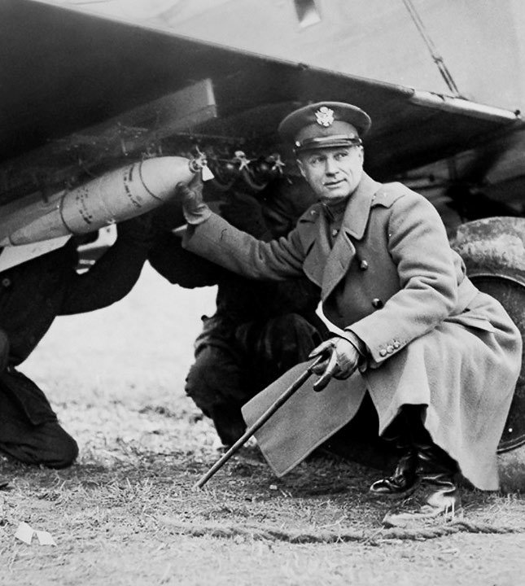
Why ACTS Mattered
Founded in 1920 as the U.S. Army’s first advanced professional school for air officers.
It trained officers, tested ideas, and became a center for airpower doctrine between the world wars.
Its most famous legacy was the argument that long-range bombers could strike an enemy’s key industrial targets in daylight.
Many future World War II air leaders studied or taught there.
Early advocates such as Billy Mitchell influenced the wider debate over independent airpower.

Slide 7
Origins at Langley Field, VA
Opened on 1 November 1920 as the Air Service Field Officers School.
Opened on 1 November 1920 as the Air Service Field Officers School.
Renamed the Air Service Tactical School in 1922 and the Air Corps Tactical School in 1926.
The early course mixed classroom work with flying, map reading, staff work, and tactical problems.
Small classes and debate-heavy teaching gave instructors unusual influence over doctrine.
1920
Founded at Langley
Renamed the Air Service Tactical School in 1922 and the Air Corps Tactical School in 1926.
The early course mixed classroom work with flying, map reading, staff work, and tactical problems.
1922
“Tactical School” name adopted
Small classes and debate-heavy teaching gave instructors unusual influence over doctrine.
1926
“Air Corps” added

Slide 8

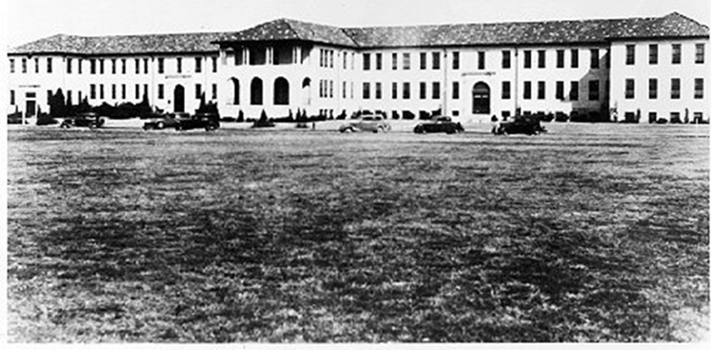
Move to Maxwell Field, AL
The school relocated to Maxwell Field in July 1931.
Maxwell offered more room, better flying conditions, and a purpose-built academic setting.
At Maxwell, the school matured into the Air Corps’ main intellectual center for strategy and doctrine.
Austin Hall
(Maxwell Field)
Maxwell became the long-term home of advanced U.S. air education and later Air University.
UNCLASSIFIED

Slide 9
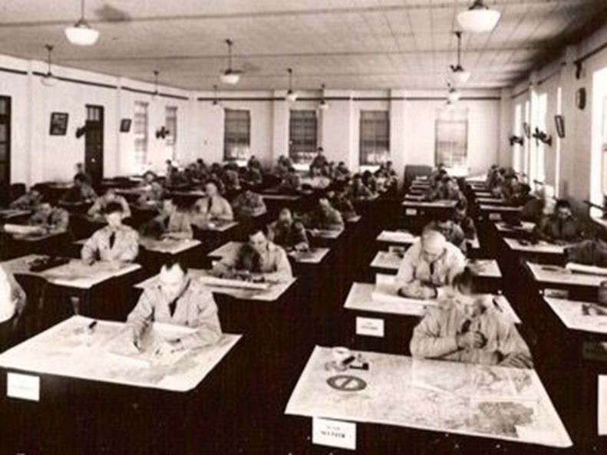
ACTS Curriculum
Air tactics and strategy dominated the curriculum.
Students also studied ground cooperation, logistics, staff work, technology, navigation, meteorology, and military law.
Lectures were often followed by guided discussion and argument, which helped refine doctrine.
The school was small, but it functioned like a laboratory for ideas.
Curriculum emphasis shifted steadily toward airpower theory in the 1930s.

Slide 10
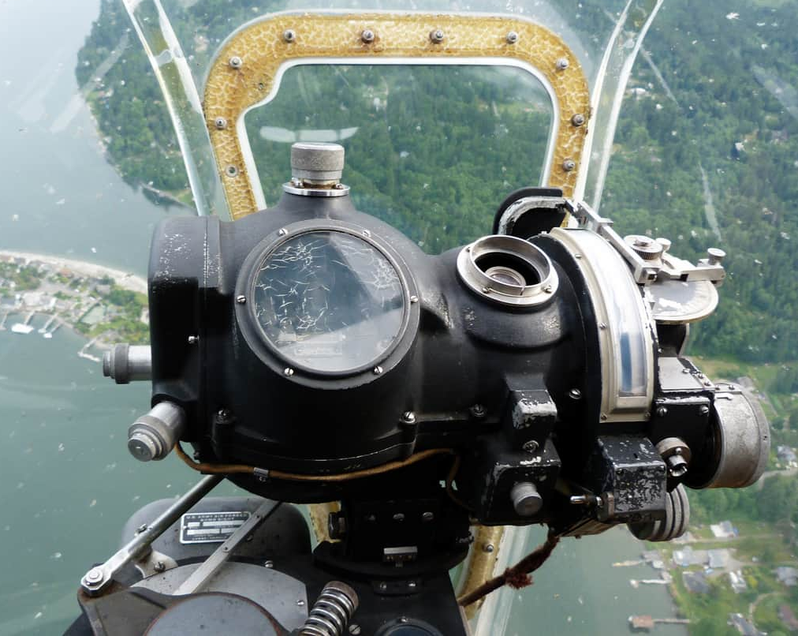
The “Bomber” Idea
A group of instructors argued that well-armed, long-range bombers could penetrate defenses in daylight.
They believed precise attacks on power, transportation, and industry could paralyze an enemy’s war-making capacity.
This became known as the theory of daylight precision bombing.
Critics warned that the theory underestimated enemy fighters, weather, and bombing accuracy.
Find critical targets
Strike in daylight
Disrupt the enemy system
Norden Bombsight

Slide 11
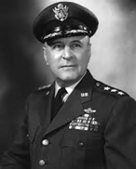
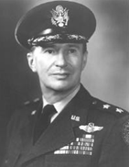
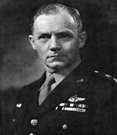
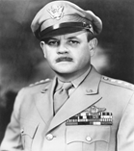
“The Bomber Mafia”
Harold L. George Leading bombardment theorist
Later a major WWII planner
Haywood S. Hansell Later a major WWII planner
Donald Wilson Advocated targeting industrial “webs”
Muir S. Fairchild Important teacher and organizer

Slide 12
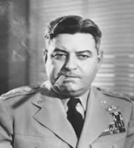
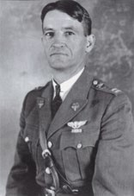
Competing Theorists of Airpower
Bombing leader who emphasized massed formations and escort integration
Curtis E. LeMay
Fighter tactician and critic of daylight precision bombing assumptions
Claire Chennault
UNCLASSIFIED

Slide 13
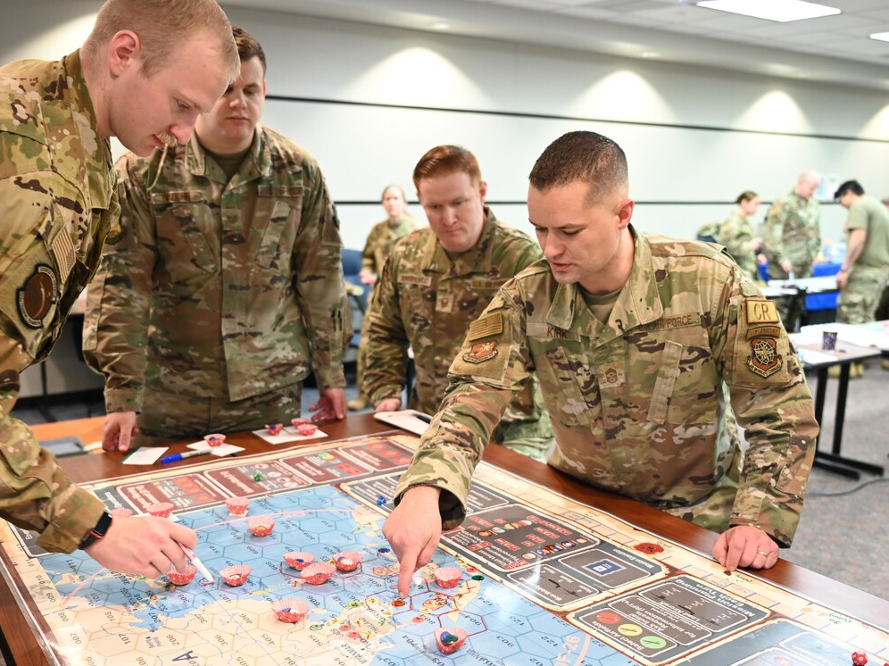

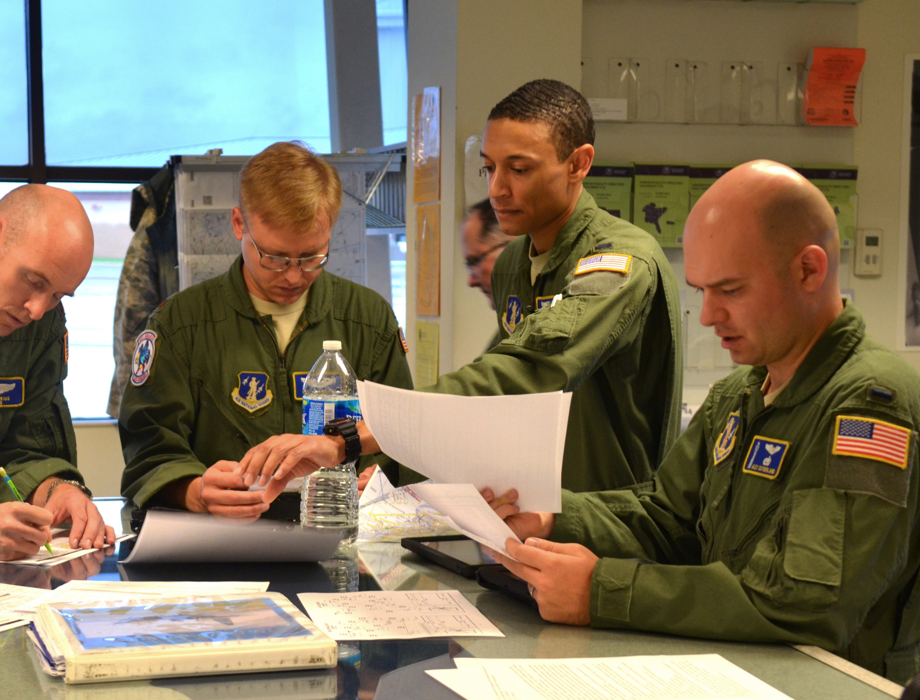

Slide 14

Mr. Dave “Sugar” Lyle
LeMay Center

Slide 15
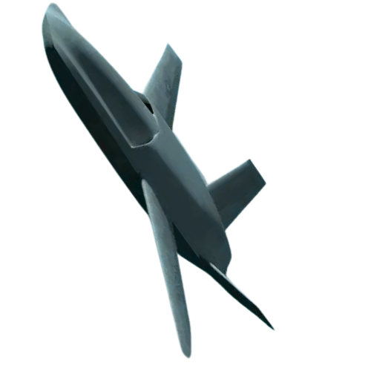
Purpose of AFD35
Air Force Doctrine 2035 will scout emerging technologies and assess their impact on airpower doctrine. AFD35 will equip Airmen with forward-looking doctrine that harnesses the technological advances of the coming decade. Our goal is to prevent doctrinal surprise, avoid doctrinal stagnation, and catalyze doctrinal evolution to match the accelerated pace of technological change.
“Victory smiles upon those who anticipate the changes in the character of war, not upon those who wait to adapt themselves after the changes occur.”
- Giulio Douhet
Notes:
Explain that AFD35 is a proactive initiative to shape doctrine ahead of operational surprises.

Slide 16
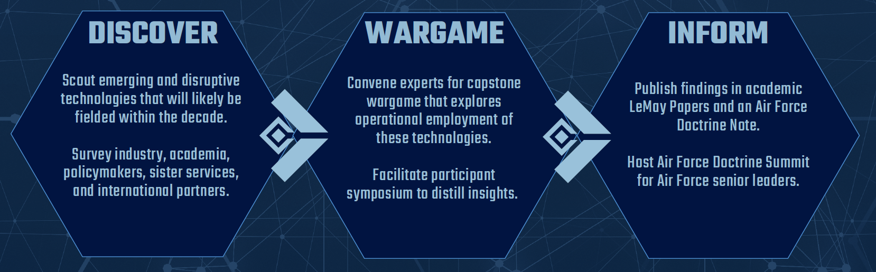
AFD35
Notes:
Walk through the AFD35 pipeline from research to output, reinforcing structured rigor.

Slide 17

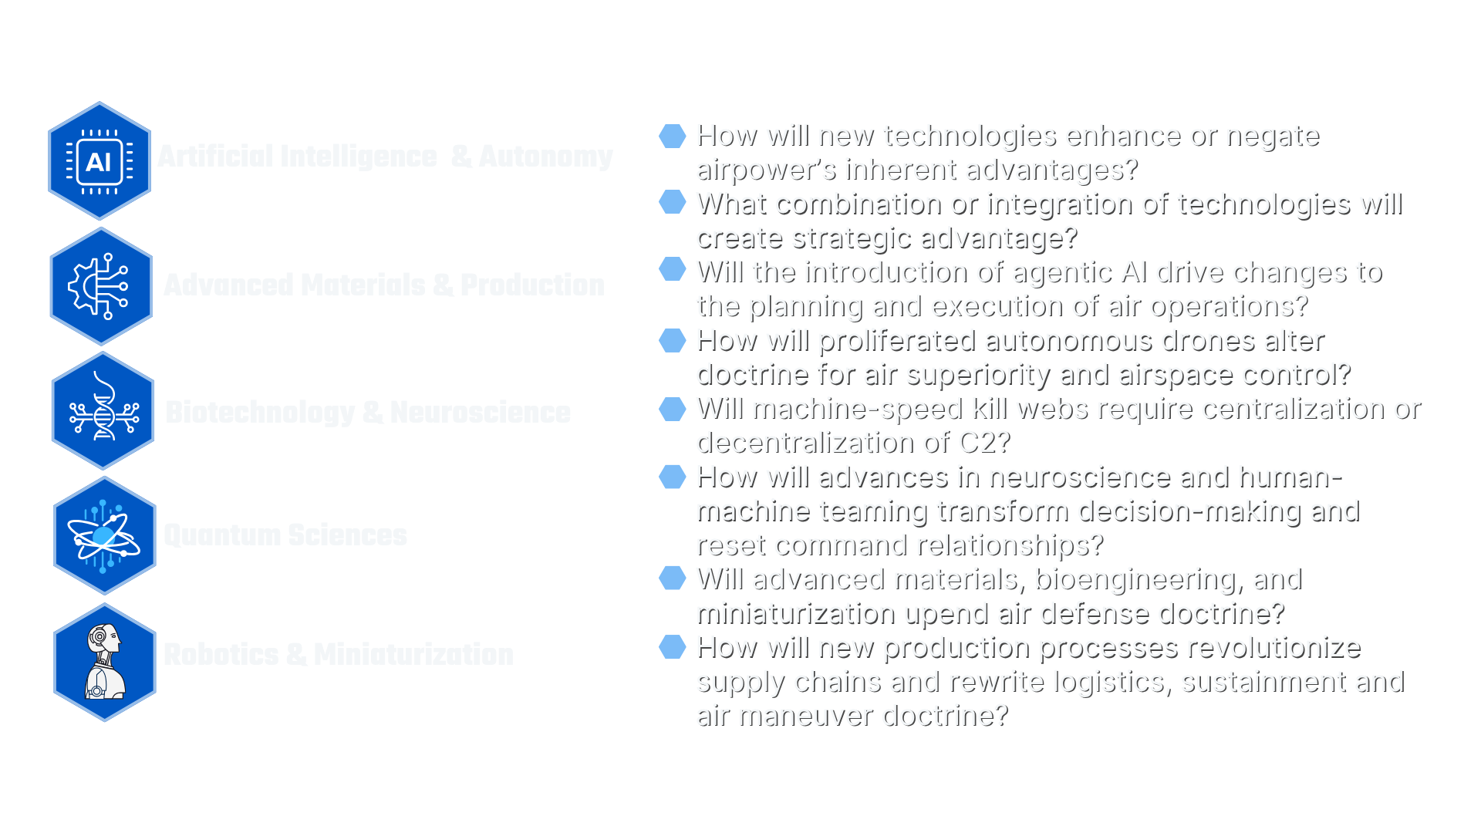



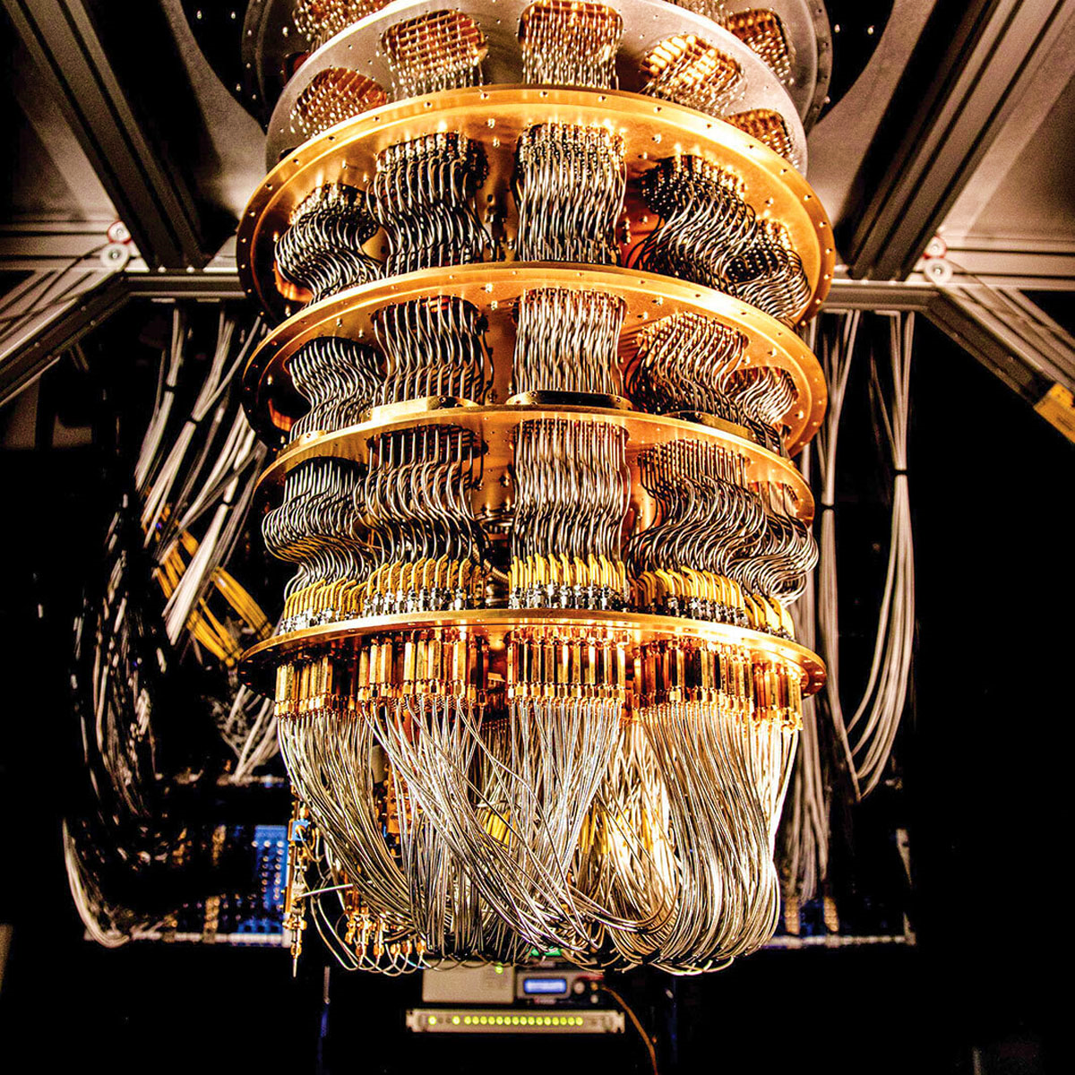
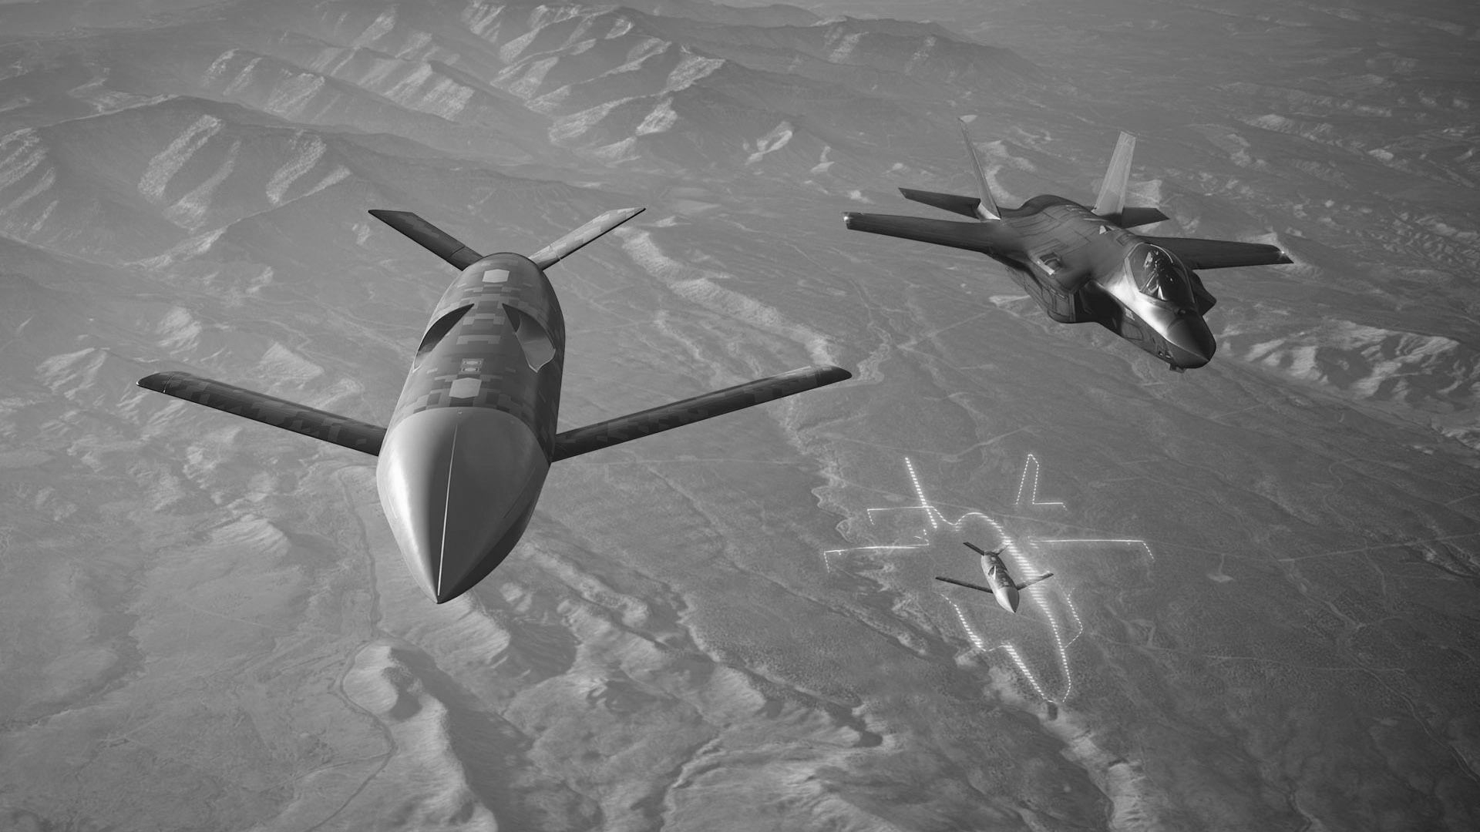
AFD35 Tech Landscape
AI Autonomy
Advanced Manufacturing and Production
Cognitive Offloading
Decision Support
Discovery
“Out of the Loop”
Artificial General Intelligence
Rare Earths
Additive Manufacturing
Metametals
Adaptive Production
Brain Computer Interfaces
Wearables
Bio-Manufacturing
CRISPR
Computers
Communications
Timing/Navigation
Sensing
Drones/Swarms
CCAs
Uncrewed Tankers/Airlift
Micro-ISR
Nano
AI
&
AUTONOMY
ADVANCED
MATERIALS
&
PRODUCTION
BIOTECH
&
NEUROSCIENCE
QUANTUM
SCIENCES
ROBOTICS
&
MINIATURIZATION

Slide 18






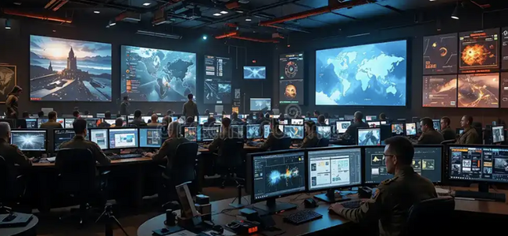

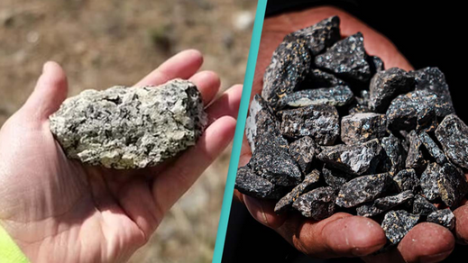

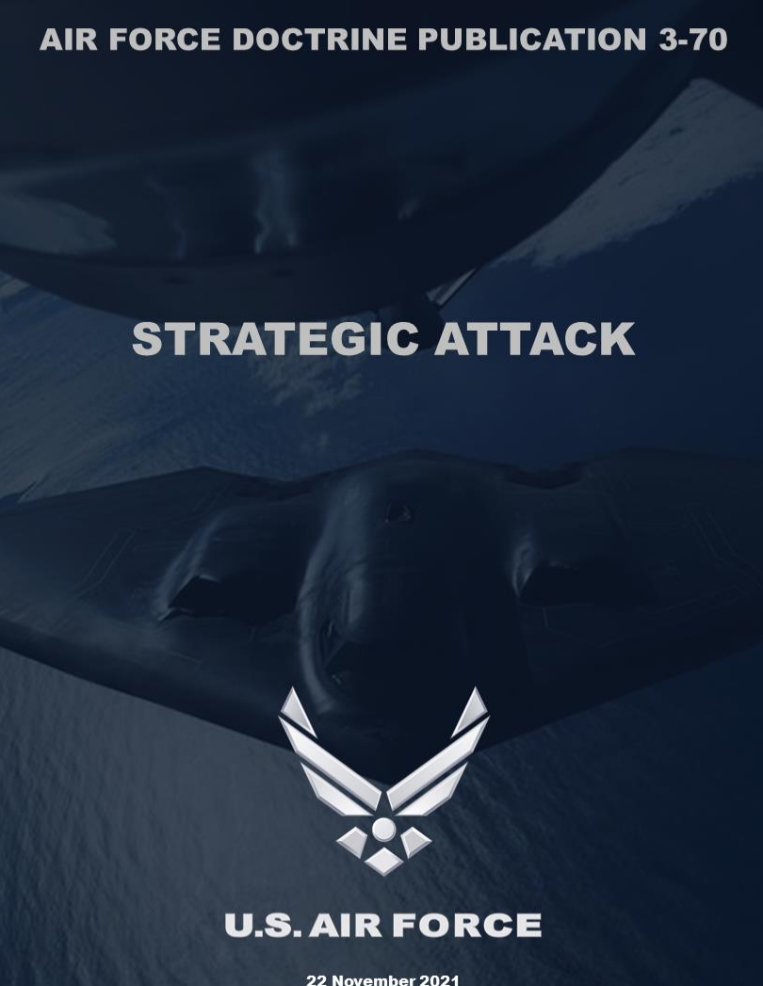
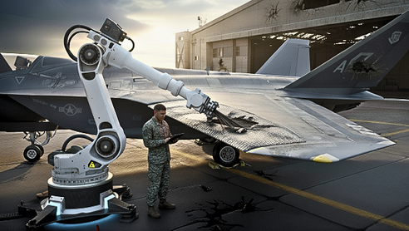


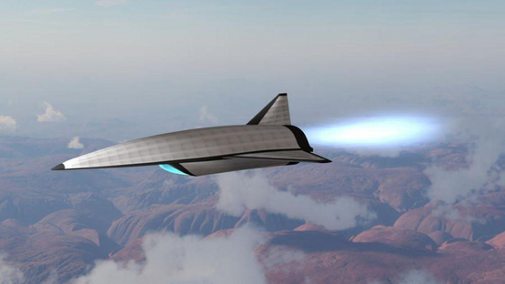



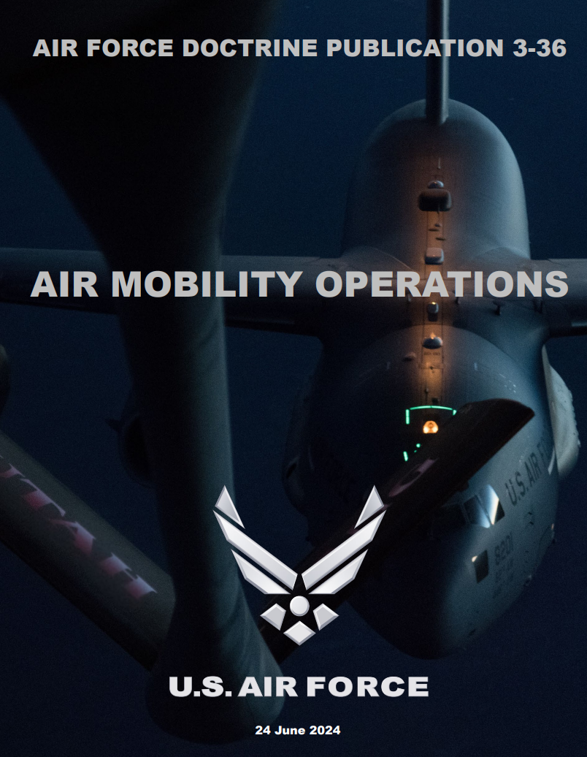


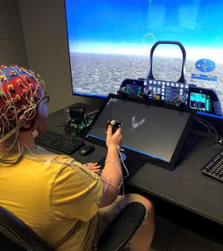






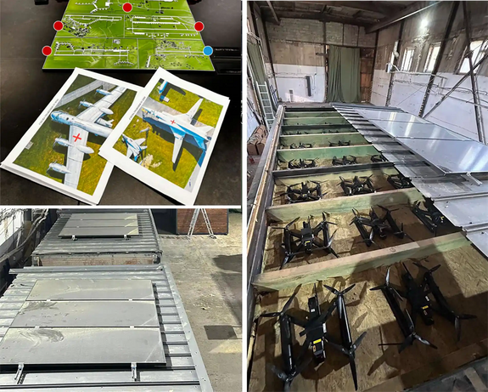
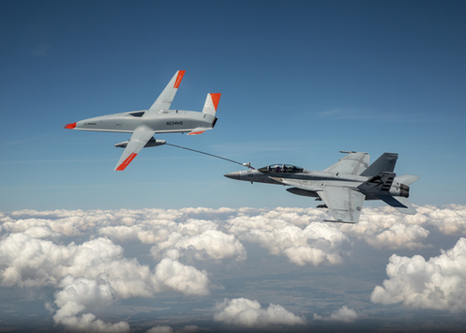

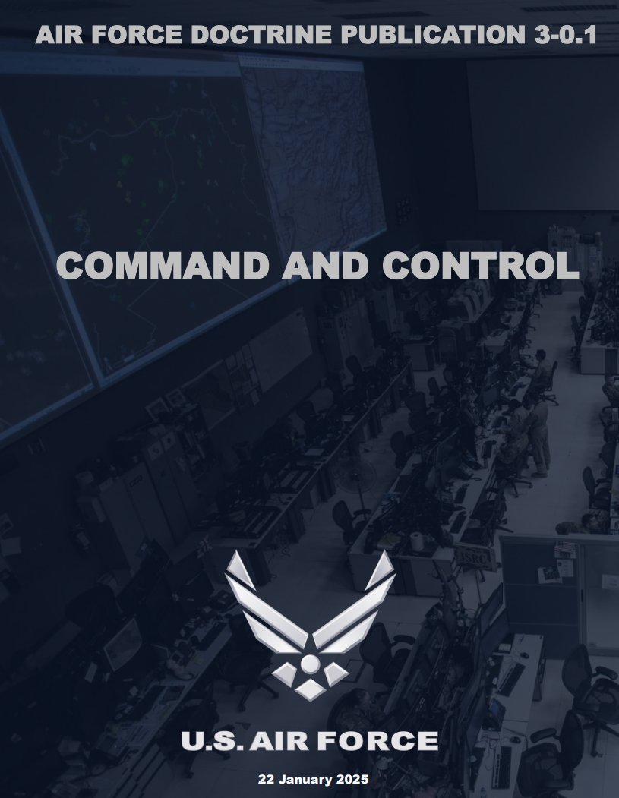
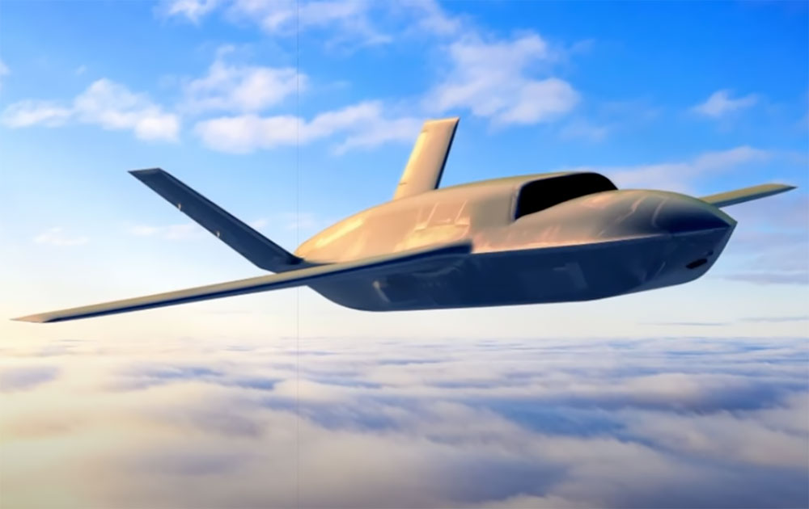
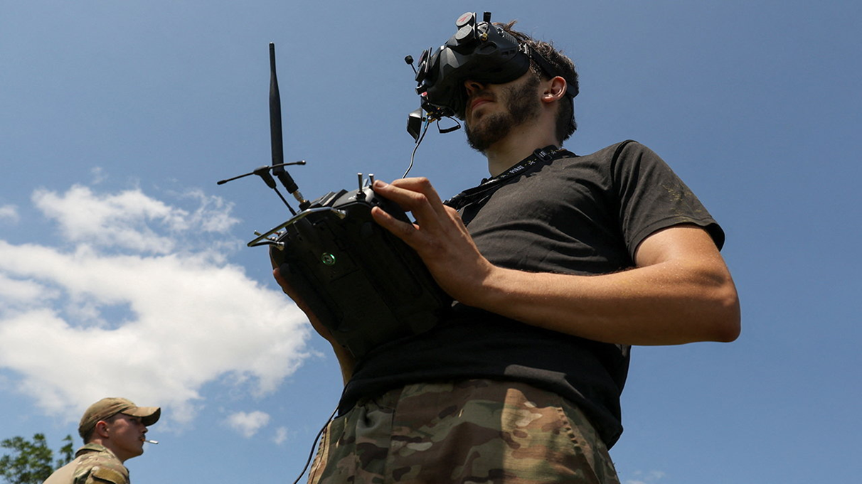
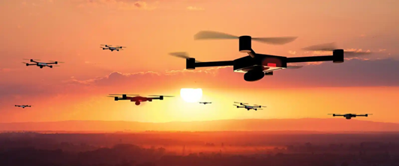

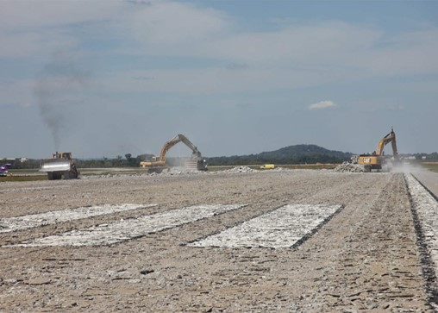
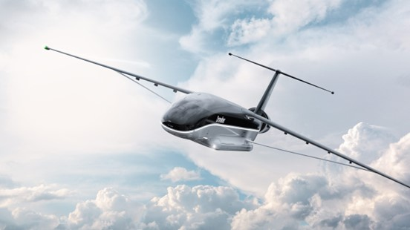
Notes:
Spiderweb trailer/drones
UKR FPV drones
CCAs
Pilot/Brain computer interface
CRSPR / DNA helix
Swarming microdrones
Mothership
Unmanned tanker
Unmanned airlift
Bioweapon
Organic concrete
LO metamaterials
Magnetic navigation
Quantum computer
Neuromorphic chip
Additive manufacturing
Modern C2/battle cab
Malicious code
Info ops meme
Wearables
Biomanufacturing
Rare earths
Hypersonic glide vehicle

Slide 19
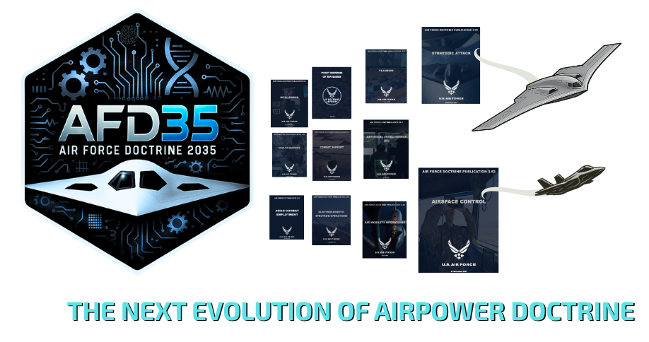
“At the very heart of warfare lies doctrine.”
— Gen Curtis E. LeMay
Notes:
End with a compelling reminder of doctrine's centrality to warfighting success.

Slide 20
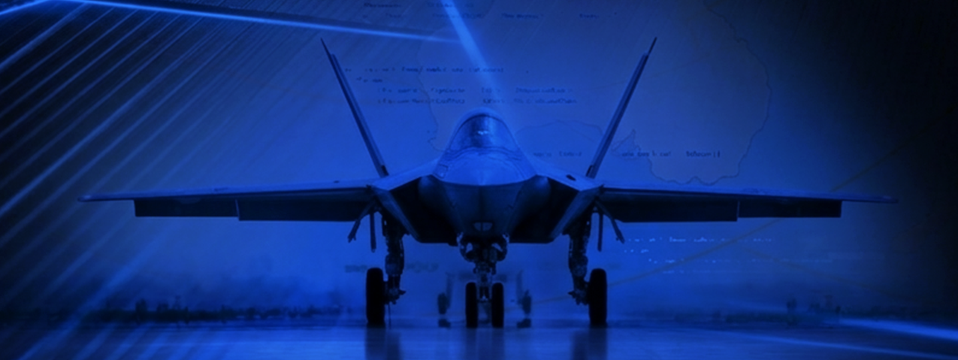
Red Threat
Josh Baughman
China Aerospace Studies Institute
Disclaimer: This briefing is UNCLASSIFIED and generated from open source and fictitious game material and is intended ONLY FOR USE DURING THE AFD35 WARGAME. This DOES NOT represent an official position of the US Government, Department of War, Air Force, or the LeMay Center. It should not be treated as verified intelligence or assessment. It should not be reproduced or disseminated without prior written authorization from the LeMay Center.
UNCLASSIFIED/ FOR WARGAME PURPOSES ONLY

Slide 21
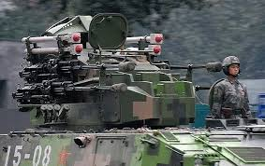
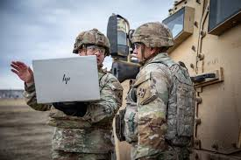

PLA Modernization Framework
Mechanization
  Advanced machinery, vehicles, and equipment
Informatization
  Information systems, networks, and data
Intelligentization (first cited 2019)
  Transformative impact of advanced technologies
UNCLASSIFIED/ FOR WARGAME PURPOSES ONLY

Slide 22
15th Five-Year Plan (2026–2030)
Marks a sharper, more security-driven technology agenda than its predecessor.
14th Five-Year-Plan was drafted before Washington’s sweeping 2022–2025 semiconductor-related export controls and investment restrictions—and before generative AI became the defining field of technological competition.
It is much more explicit about breaking bottlenecks, securing “strategic initiative,” and reorganizing state support around resilient control of critical technologies and rapid deployment at scale.
Technological Supremacy and Self Reliance
UNCLASSIFIED/ FOR WARGAME PURPOSES ONLY

Slide 23
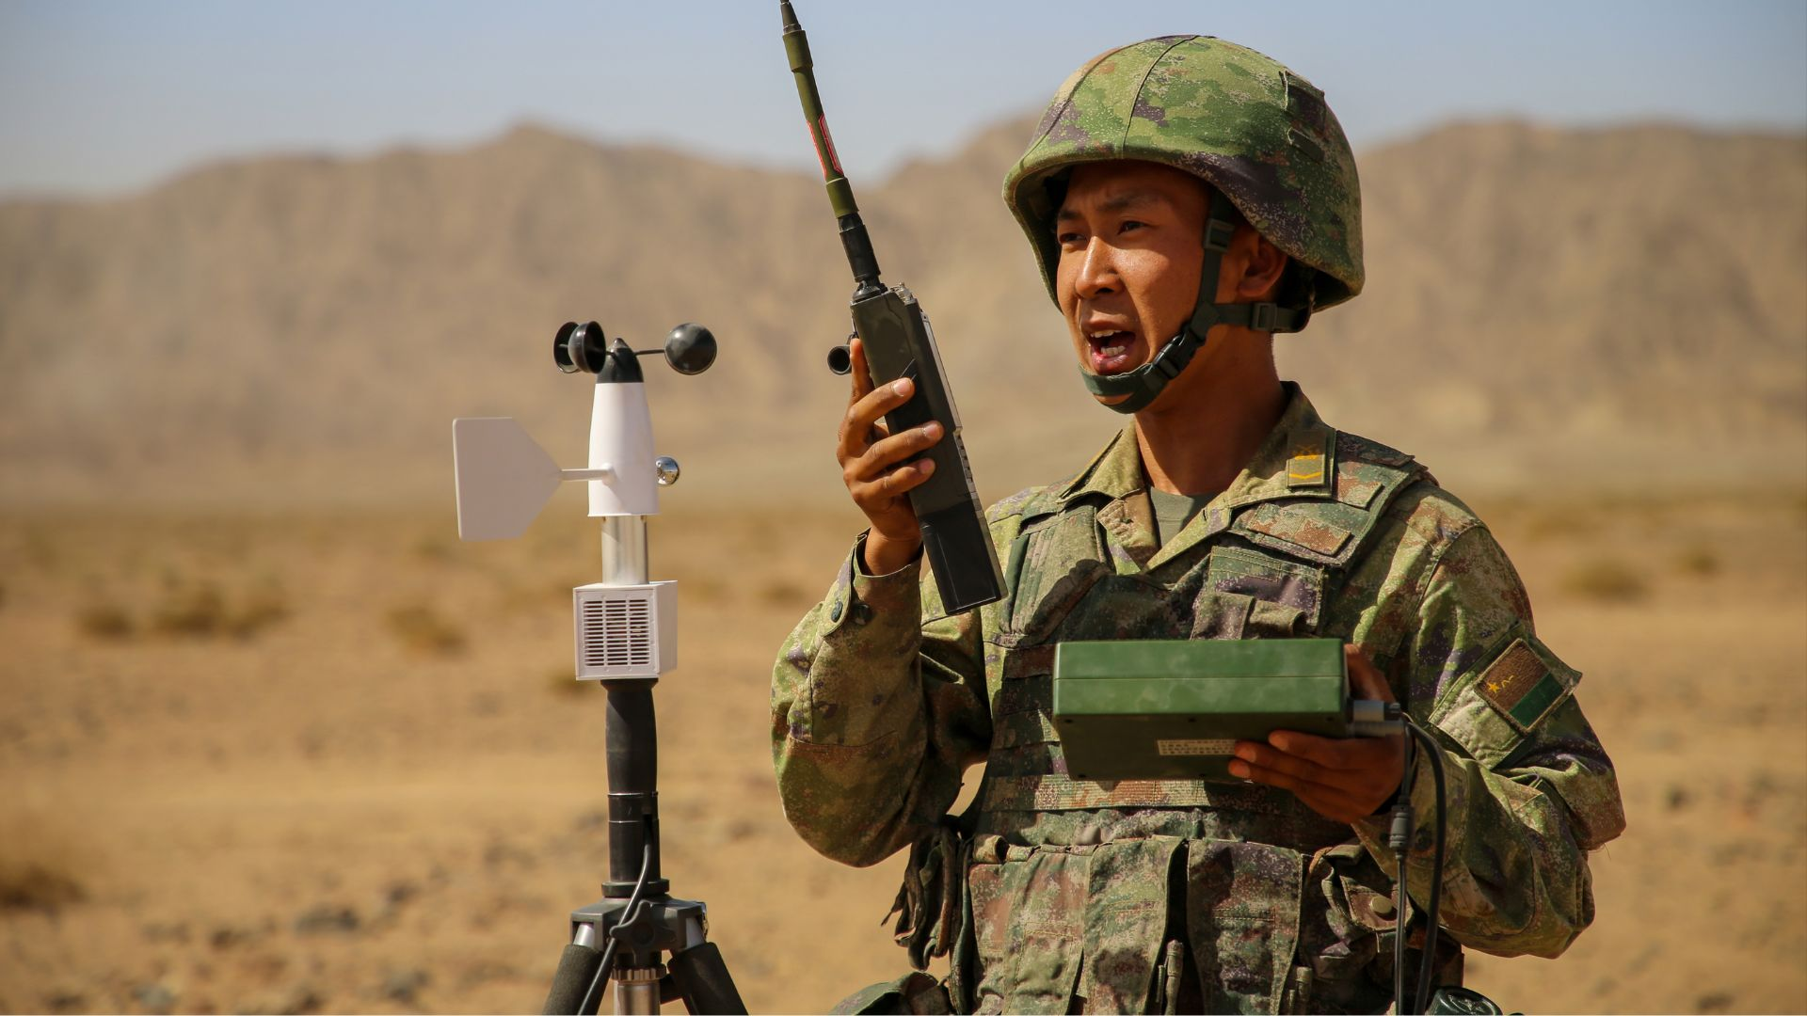

Quantum Sciences
Brute Force - centralized, state-directed
Close integration between state research labs, defense-affiliated firms, and PLA
2nd largest ecosystem
15th Five-Year Plan designates quantum as the country’s top “future industry”
Information Support Force role
Highly secretive
Leads the world in quantum communications - cryptography
Subsequent state-directed R&D in quantum computing and quantum sensing
UNCLASSIFIED/ FOR WARGAME PURPOSES ONLY

Slide 24
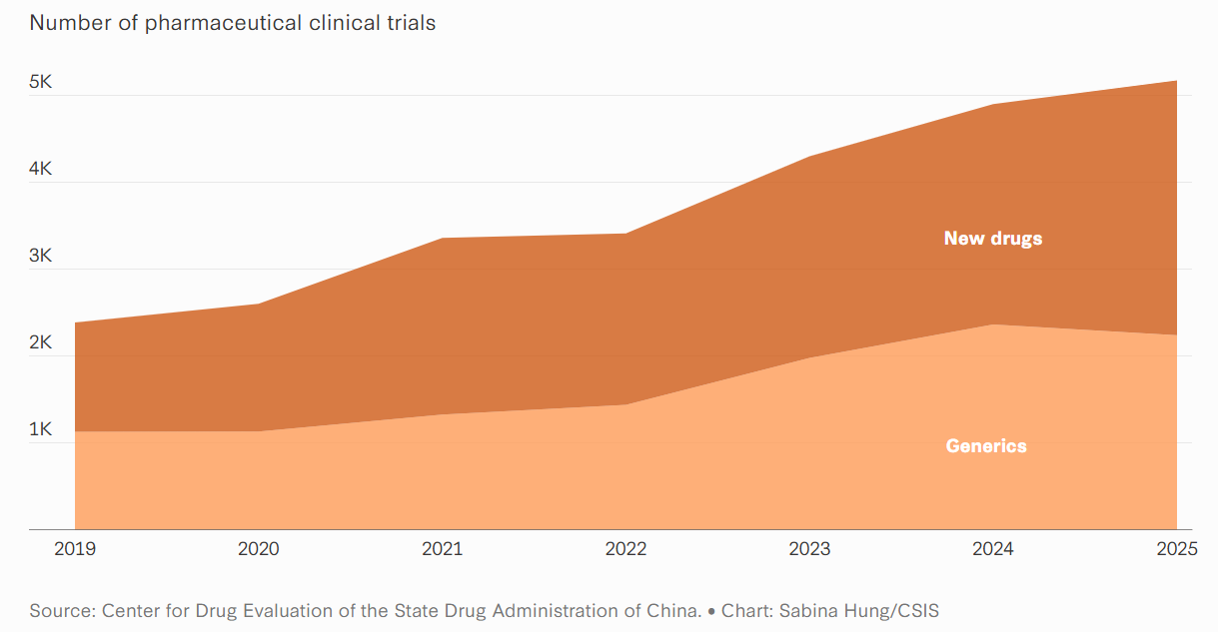

Biotechnology & Neuroscience
2020 SMS elevated biotechnology to a strategic domain of national security
Offensive - highly targeted, potentially reversible biological effects designed to limit collateral damage
Second-largest developer of new drugs
BCI: Shanghai-based Neuracle Medical Technology received a commercial-use approval for an implantable brain-computer interface (semi-invasive)
UNCLASSIFIED/ FOR WARGAME PURPOSES ONLY

Slide 25
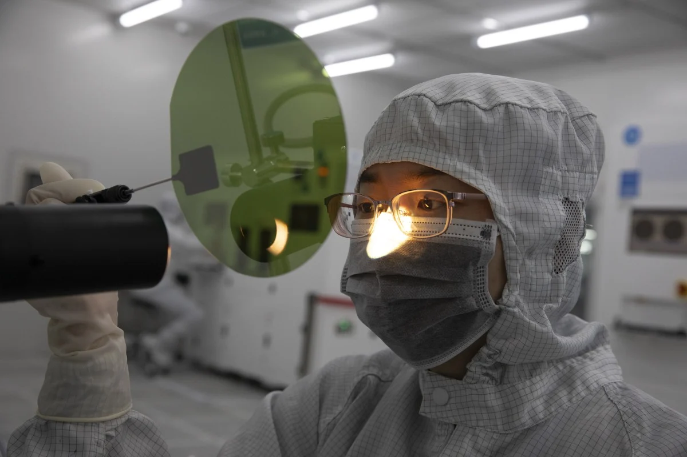
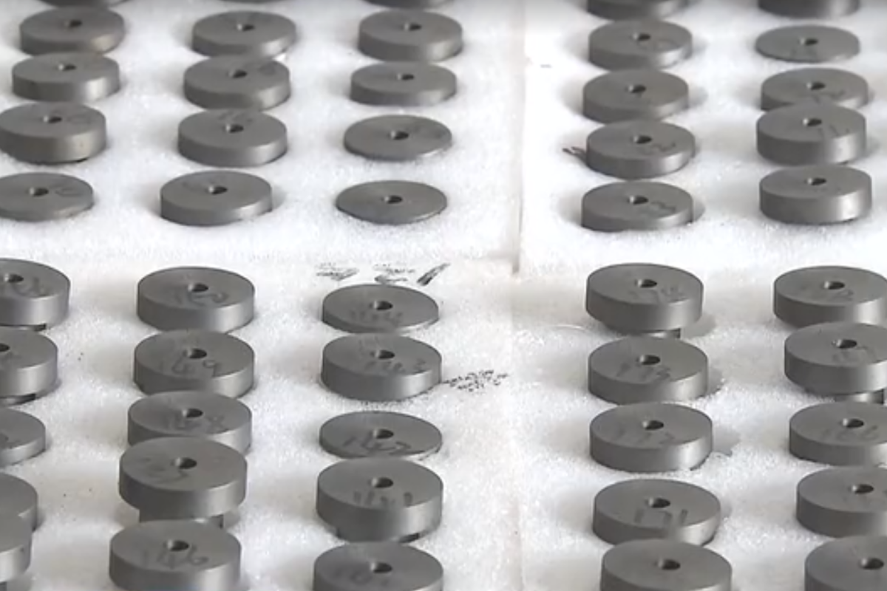
Advanced Materials & Production
Foundational layer for industrial resilience and wartime scalability
15th Five-Year Plan calls for “breakthroughs in high-performance materials, advanced structural materials, and advanced functional materials.”
Priorities: carbon fiber composites, advanced alloys, ceramics, electronic glass, and photoresists
Additive - Improved sustainment and force regeneration
UNCLASSIFIED/ FOR WARGAME PURPOSES ONLY

Slide 26
AI & Autonomy
AI mentioned 52 times in 15th Five Year Plan
AI+ links AI to science, industry, culture, public services, and governance -“accelerate” initiatives to develop and diffuse AI
AI Ecosystem: unmanned systems, intelligence, surveillance and reconnaissance (ISR), decision support, cyber operations, targeting, information warfare, and logistics
Multi-Domain Precision Warfare (MDPW) - AI-enabled rapid information processing and decision-making
Cognitive Warfare Applications
Open Source/ commercial off-the-shelf products and military-specific systems
UNCLASSIFIED/ FOR WARGAME PURPOSES ONLY

Slide 27

Robotics & Miniaturization
Economic engine and a pillar of national security
AI-enabled robotics are seen as a way to offset limited combat experience while exploiting China’s unmatched manufacturing depth.
80 percent of the world’s small drones (US “lagging”)
Swarms: “Algorithm-driven, with unmanned systems as the primary fighting force and swarm operations as the primary mode of combat
Names robots, particularly humanoid versions, as among critical strategic industries—and elevates embodied intelligence to the same tier as quantum technology, brain-computer interfaces, 6G, and nuclear fusion.
UNCLASSIFIED/ FOR WARGAME PURPOSES ONLY

Slide 28
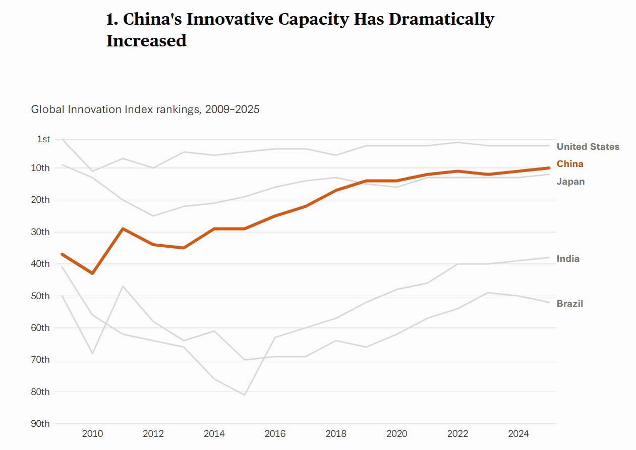
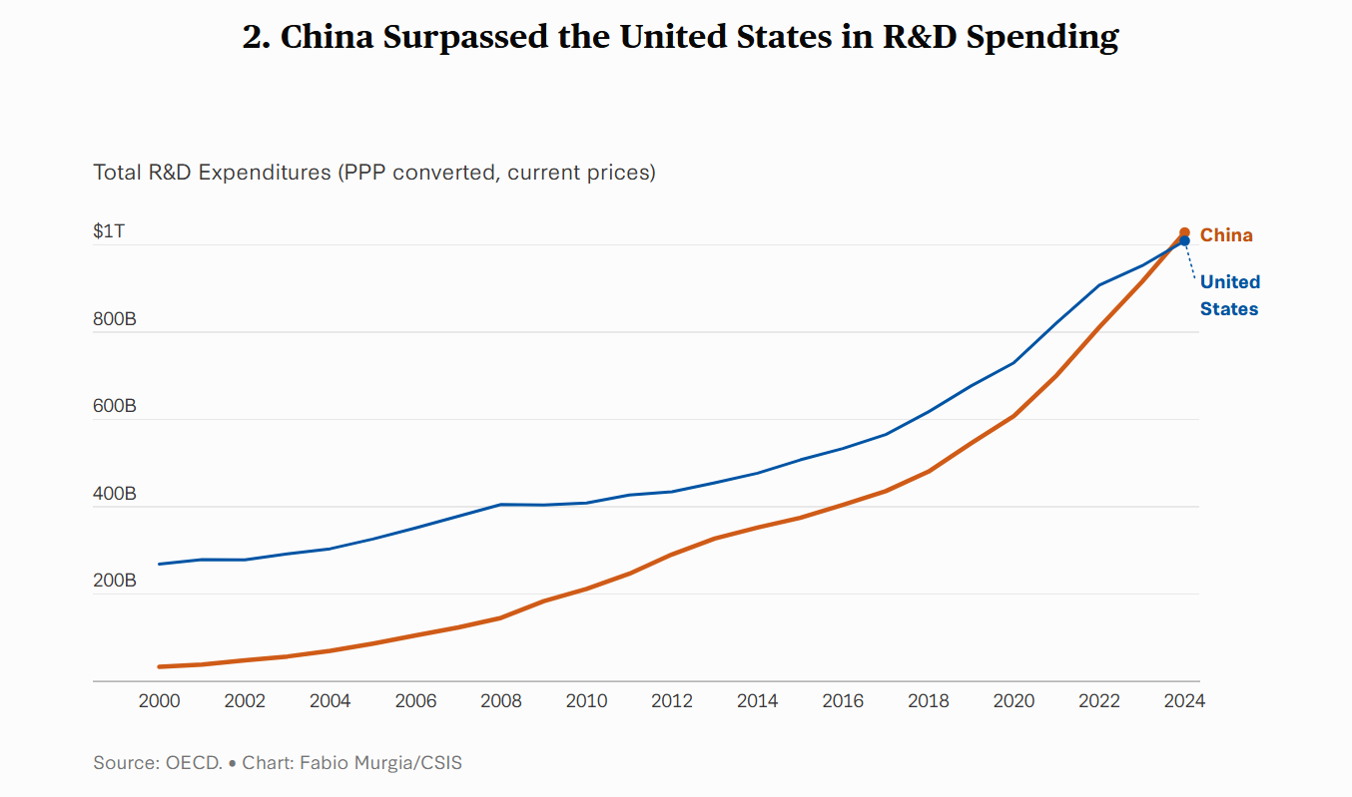
“Win the Future”
UNCLASSIFIED/ FOR WARGAME PURPOSES ONLY

Slide 29
Wargame Administration
Lt Col Steven “Po” O’Dell
LeMay Center

Slide 30
Disclaimers
The scenario fictitious. In no way does it represent the position of the US Government, Department of War, Air Force, or the LeMay Center. In no way does it represent the position of the US Government, Department of War, Air Force, or the LeMay Center.
All gameplay and discussions are to remain UNCLASSIFIED. Please do not discuss, confirm, or deny classified material at any time.
Conversation in large rooms will be recorded. There are no guarantees of confidentiality for any information disclosed during the wargame or related activities. Participants are solely responsible for protecting their own intellectual property, trade secrets, and proprietary information.
We also ask you to respect Air University’s non-attribution policy for other participants to freely promote the exploration of ideas and concepts.
The LeMay Center may, at its discretion, release unclassified insights and game outputs. There are no guarantees of confidentiality for any information disclosed during the wargame or related activities. Participants are solely responsible for protecting their own intellectual property, trade secrets, and proprietary information.
The participation of any organization or the use of any technology during or related to this wargame, does not constitute or imply an endorsement by the Department of War, the United States Air Force, or the LeMay Center.
Notes:
The scenario is fully fictional and does not represent actual intelligence analysis nor threat assessment. In no way does it represent the position of the US Government, Department of War, Air Force, or the LeMay Center. The game is being held at the UNCLASSIFIED level to include diverse perspectives. Please do not discuss, confirm, or deny classified material at any time. We also ask you to respect Air University’s non-attribution policy for other participants to freely promote the exploration of ideas and concepts. The LeMay Center may, at its discretion, release unclassified insights and game outputs. There are no guarantees of confidentiality for any information disclosed during the wargame or related activities. Participants are solely responsible for protecting their own intellectual property, trade secrets, and proprietary information. The participation of any organization or the use of any technology during or related to this wargame, does not constitute or imply an endorsement by the Department of War, the United States Air Force, or the LeMay Center.

Slide 31
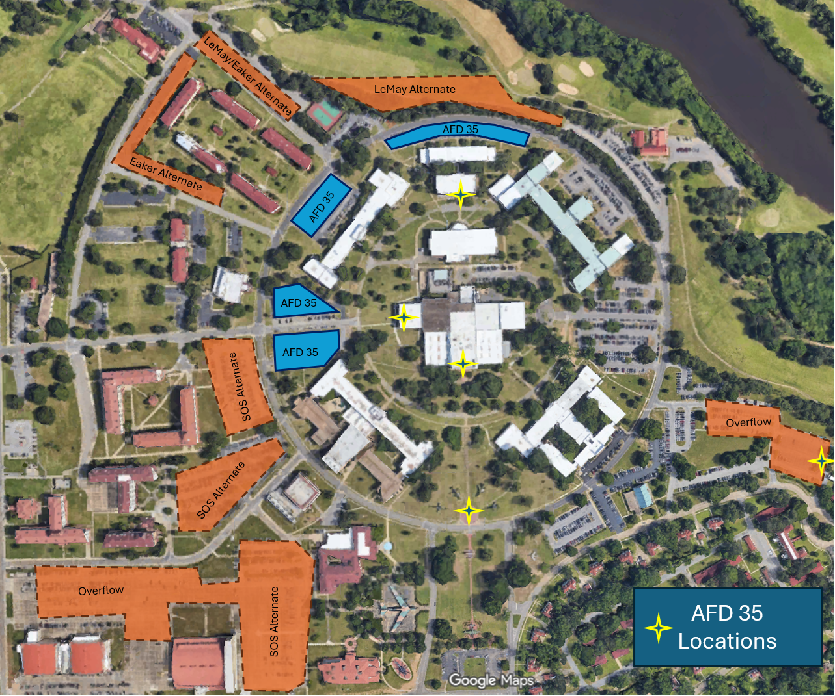

Slide 32
In Case of Emergency
Follow the directions of the closest LeMay Center personnel
If directed to evacuate, rally one of the three parking lots on the interior of the academic circle

Slide 33
Team Introductions
Overall Event Management/Room Breakouts – Lt Col Steven “Po” O’Dell
Base Access/Hospitality/Lunches - Mrs. Sheila McKitt
Technology/Internet – Col Charles “Gator” Spaulding
Base Access/Technology/Bios – Maj Joshua “Vlad” Bryant
Expert Panel – Dr. J. William “Bill” DeMarco
Data Capture – Mr. Kevin Williams
Doctrine – Lt Col James “Bond” Elliot
Wargaming – Mr. Lisle “Sack” Babcock

Slide 34



Slide 35

Participant Biography Logins
Registration Email
Password: Douhet2035
Please email your bio to: joshua.bryant.13@us.af.mil

Slide 36


1600 – 1700 Today
Group Photo – 1620 @ Karl Richter Statue/Air Park
Guided Airpark Tour – 1620-1640
Icebreaker Social – 1700 – 1900 @ Maxwell Club “The Pit”
All encouraged to attend
Heavy hors d’oeuvres with landing fee or for $15
Pay-as-you-pour bar
LeMay/Eaker Alternate
LeMay Alternate
AFD 35
Eaker Alternate
AFD 35
AFD 35
SOS Alternate
AFD 35
Overflow
SOS Alternate
Overflow
SOS Alternate
AFD 35 Locations

Slide 37
On-Camera Interviews
If you would be willing to be briefly interviewed by Air Force Public Affairs, please sign up in lobby.
An escort will retrieve you from your breakout room Wednesday afternoon
    Questions:
    In your view what does the advanced technology landscape look like in 2035 and beyond?
    From your perspective how do you think advanced technologies will change the Air Force?
    From your perspective, how was the overall Wargame Experience?
DISCLAIMER
By participating in an interview, you consent to being recorded and thereafter authorize the LeMay Center to use, quote, and publish your statements, in whole or in part, across its various print, digital, and affiliated media platforms without prior approval. All on-the-record comments may be used in current and future reporting.

Slide 38



Slide 39
10 Min Break
Refreshments are available in the Heritage Room with paid landing fee
Restrooms outside the auditorium and to the left or through the glass tunnel
Up Next: 0930-1130 Turn 1
Role: Scientific Advisory Group to the SECAF EAG
Recommended Review: Read-Ahead Material
Timeline: 2030

Slide 40
Scientific Advisory Committee to the SECAF
April 2030
Colonel Raymond “Banzai” Rounds
Executive Action Group
Dr. J. William “Bill” DeMarco
Executive Action Group

Slide 41



Welcome to the SAG
Date: April 2030
Task: Make recommendation to SECAF on $100B supplemental R&D investments into five key technology areas
Method: Individual and collective guided discussion
Role: Expert advisors within your field
Scientific
Advisory
Group

Slide 42
Technology Areas
Cognitive Offloading
Decision Support
Discovery
“Out of the Loop”
Artificial General Intelligence
Rare Earths
Additive Manufacturing
Metametals
Adaptive Production
Brain Computer Interfaces
Wearables
Detection
Bio-Manufacturing
Therapuetics
Computers
Communications
Timing/Navigation
Sensing
Drones/Swarms
CCAs
Uncrewed Tankers/Airlift
Micro-ISR
Nano
AI
&
AUTONOMY
ADVANCED
MATERIALS
&
PRODUCTION
BIOTECH
&
NEUROSCIENCE
QUANTUM
SCIENCES
ROBOTICS
&
MINIATURIZATION

Slide 43

Day 1, Round 1 Survey
Scan the QR code to virtually submit individual investment recommendations
1000 “tokens” representing $100B
Distribute across each technology area, not to exceed 1000 tokens
Notes:
https://afd35survey.netlify.app/
https://docs.google.com/spreadsheets/d/17juTwjaMIErF07IojMapNDS-SlWf84kXXUKFnpPWj8k/edit?usp=sharing

Slide 44
Rules of Engagement
Conversations are being recorded for LeMay Center analysis
AU non-attribution policy
No one is an expert at everything, so don’t be shy
Keep comments UNCLASSIFIED
Challenge, but respect differing viewpoints
Don’t monopolize the conversation
Raise your hand for a mic runner, go to the mics, or speak up
Begin comments with your name and your organization

Slide 45

Investments in Billions of Dollars
Technology Area

Slide 46
Day 1, Round 2 Survey
Scan the QR code to virtually submit individual investment recommendations
1000 “tokens” representing $100B
Distribute across each technology area, not to exceed 1000 tokens

Slide 47

Lunch
1130 - 1230
Purchased lunches available in the lobby
Recommend eating on base due to timing/options
  Dining Court in Exchange (Popeyes, Qdoba, O’Charley’s)
  Burger King at Shoppette/Gas Station
  AU Shoppette
Meeting for Day 2 Key Personnel in GO Library
Up Next: 0930-1130 Turn 1
Role: Scientific Advisory Group to HAF/AQ
Recommended Review: Read-Ahead Material
Timeline: 2031
Google Maps Locations

Slide 48
Scientific Advisory Committee to SAF/AQ
April 2031
Colonel Raymond “Banzai” Rounds
Executive Action Group
Dr. J. William “Bill” DeMarco
Executive Action Group

Slide 49
State of Technology
Cognitive Offloading
Decision Support
Discovery
“Out of the Loop”
Artificial General Intelligence
Rare Earths
Additive Manufacturing
Metametals
Adaptive Production
Brain Computer Interfaces
Wearables
Detection
Bio-Manufacturing
Therapuetics
Computers
Communications
Timing/Navigation
Sensing
Drones/Swarms
CCAs
Uncrewed Tankers/Airlift
Micro-ISR
Nano
AI
&
AUTONOMY
ADVANCED
MATERIALS
&
PRODUCTION
BIOTECH
&
NEUROSCIENCE
QUANTUM
SCIENCES
ROBOTICS
&
MINIATURIZATION

Slide 50
AI & Autonomy
BLUF: A future with lower investment in AI and autonomy would likely result in a 2031 landscape where Large Language Models (LLMs) are more specialized and efficient rather than massively scaled. Progress would shift from creating ever-larger, resource-intensive models to a focus on efficiency, specialization, and the use of synthetic data to overcome the high costs of real-world data collection and energy consumption.
Despite this shift, persistent failure modes would remain significant challenges. Without substantial investment in fundamental research to address core limitations, issues like hallucinations (generating plausible but false outputs), bias inherited from training data, and poor explainability will continue to undermine trust and reliability.
Energy consumption would remain a major constraint. While more efficient, specialized models would consume less power than their scaled-up counterparts, the overall energy demand for AI would still be substantial, especially as inference costs for complex reasoning tasks continue to rise.
The development of advanced multimodal models that seamlessly integrate text, image, and audio would be slower. Progress would be incremental, focusing on niche applications rather than achieving widespread, humanlike multimodal understanding.
Finally, vulnerability to adversarial attacks would persist as a critical risk. With reduced investment, the development of robust, scalable security defenses would continue to lag behind the rapid emergence of new attack methods. This would leave AI systems, especially those integrated into critical infrastructure, susceptible to manipulation and failure, creating a significant and ongoing security gap.

Slide 51
Advanced Materials & Production
BLUF: Assuming lower-than-normal investment in advanced production techniques and material science, the future in 2031would be one of slowed progress and missed opportunities.
Additive manufacturing would advance incrementally, but the development of novel, high-performance materials would stagnate. This would limit its application in creating complex, durable components for critical sectors like aerospace and defense. Similarly, the development of new heat-resistant materials would be sluggish, hindering progress in fields that require operation in extreme environments, such as hypersonics and advanced energy systems.
In the energy sector, the deployment of small modular reactors (SMRs) would face significant delays. Lower investment would slow down the prototyping, testing, and regulatory approval of new reactor designs, pushing their potential contribution to clean energy further into the future.
The development of directed energy weapons and advanced laser communications would also be hampered. Without breakthroughs in materials and manufacturing, these systems would struggle to achieve the power, efficiency, and reliability needed for widespread military and commercial adoption. The US would risk falling behind other nations that continue to prioritize these strategic technologies.
Overall, a future with underinvestment in these areas would lead to a less resilient, less competitive, and more technologically dependent United States, with a slower transition to advanced energy and defense capabilities.

Slide 52
Biotechnology & Neuroscience
BLUF: Assuming low levels of investment in biosecurity and neuroscience, the year 2031 would be a future of unrealized potential and heightened risk.
Progress in biomanufacturing and synthetic biology would be slow and fragmented. The U.S. would fail to scale foundational technologies, relying on a struggling private sector and ceding leadership to competitors like China. This would leave the nation vulnerable to "biotechnological surprise" and dependent on foreign supply chains for critical products.
The vision of distributed DNA reading and writing would remain largely unfulfilled. While some niche academic applications might exist, the lack of sustained investment would prevent the creation of the robust, secure, and accessible platforms needed for this technology to become a widespread tool for on-demand, local bioproduction.
In neuroscience, the development of new therapeutics for conditions like Alzheimer's and addiction would stagnate. The already long and costly pipeline for new drugs would be further hampered, leaving patients with few new options. While some advances in biomonitoring would occur, truly transformative brain-machine interfaces would remain in the realm of research labs. The search for novel, non-addictive stimulants or pain treatments would see little progress.
Most critically, this slow internal progress would be dangerously mismatched with the low investment in biosecurity. As biotechnology tools become easier to access globally, the U.S. would lack the advanced monitoring and defense capabilities to counter their potential misuse, leaving the nation exposed to both accidental and deliberate biological threats.

Slide 53
Quantum Sciences
BLUF: Assuming lower-than-normal levels of investment in quantum science, the future in 2031 would be one of significant strategic risk and slowed innovation for the United States.
Quantum Computing would remain largely confined to academic and corporate research labs. While companies might demonstrate machines with thousands of physical qubits, the development of fault-tolerant systems with sufficient logical qubits for practical applications would be severely delayed. The immense challenge of error correction would not be overcome, pushing the timeline for breaking current encryption schemes well beyond 2031.
Quantum Modeling and Simulation, the most mature application of quantum computers, would see limited use. It would be applied to solve niche scientific problems, but the hardware's scale and reliability would be insufficient to tackle complex industrial challenges in drug discovery or materials science, preventing it from delivering on its economic promise.
Quantum Communications, particularly for key distribution (QKD), would not see widespread adoption. Given the slow progress in building a threatening quantum computer, the primary motivation for deploying these expensive and complex networks would be diminished. The focus for data security would remain firmly on developing and deploying software-based, post-quantum cryptographic algorithms, with QKD remaining a niche, experimental technology.
Quantum Precision Navigation and Timing (PNT) would see the most real-world impact, but its potential would be constrained. While quantum sensors would be integrated into high-value scientific instruments and specialized military systems, the engineering challenges of creating rugged, cost-effective, and compact devices for broad commercial or military use would not be fully solved. The U.S. would risk losing its leadership position in this critical area to nations with more sustained government investment.

Slide 54
Robotics & Miniaturization
BLUF: Assuming low levels of investment in robotics and miniaturization, the future in 2031 would be one of stagnation and dependency.
In this scenario, US manufacturing would continue to lose competitiveness globally. The persistent labor shortages and supply chain vulnerabilities identified in the report would remain unaddressed. Instead of a robotics-driven renaissance, factories would rely on aging, rigid automation and an increasingly scarce human workforce, ceding ground to nations with stronger commitments to robotics.
The dominant robotic systems would be pre-programmed/trained systems designed for highly structured, repetitive tasks. These robots, common on today's assembly lines, lack the adaptability to handle dynamic environments or customized production. Innovation would stall, leaving industries unable to pivot quickly or handle complex, non-routine physical work without significant human intervention.
Robots would remain functionally tethered to human inputs and systems. Progress in autonomy would be minimal due to the lack of investment in the AI, sensors, and data-gathering necessary for independent operation. This means that for any task requiring more than simple, repetitive motion, robots would require direct human control, as seen in tele-operation. They would function as sophisticated tools rather than autonomous partners, limiting their potential to enhance productivity and forcing human workers to remain in dull, dirty, and dangerous roles.

Slide 55


Welcome Back to the SAG
Date: April 2031
Task: A year after R&D investments, suggest materiel and equipment to purchase. No
Method: Collective guided discussion
Role: Expert advisors within your field
Mission - Cost effectively modernize to deliver capability to the warfighter when needed.
Vision - Deliver enduring world class capabilities to assure air, space and cyberspace dominance for the nation and our allies
Scientific
Advisory
Group

Slide 56
Task
Given the current state of technology, what equipment, weapons, and materiel should be bought?
Assumptions:
  Current FY26 Programs remain on track (F-47, B-21, Sentinel, etc.)
  No budgetary constraints
  Maturation timeline is feasible by 2035

Slide 57
Rules of Engagement
Conversations are being recorded for LeMay Center analysis
AU non-attribution policy
No one is an expert at everything, so don’t be shy
Keep comments UNCLASSIFIED
Challenge, but respect differing viewpoints
Don’t monopolize the conversation
Raise your hand for a mic runner, go to the mics, or speak up
Begin comments with your name and your organization

Slide 58
Turn 2 Wrap-Up
Recommendations going forward

Slide 59
End of Day 1 Administration
Tomorrow will be in the Library Complex by Breakout Group (see ID)
  Breakout A – Operations in the Information Environment
  Breakout B – Air Superiority
  Breakout C – Strategic Attack
  Breakout D – Homeland Defence
  Breakout E – Agile Combat Employment
Some components of every technology area in all scenarios!
See me if you are adamantly requesting a change
Firm 0800 Start Time!

Slide 60

Library Locations
Entry
A - OIE
C – Strategic Attack
E – ACE
Signage will be up
Entry

Slide 61

Library Locations
B – Air Superiority
D – Homeland Defense
Elev.
Signage will be up

Slide 62
Reminders
Wednesday – Library
  1530 Stop, relocate to Ravello
  MGM Reception
  1630 Expert Panel
Thursday – Back here, 0800 Start

Slide 63
1600 – 1700 Today
Group Photo – 1620 @ Karl Richter Statue/Air Park
Guided Airpark Tour – 1620-1640
Icebreaker Social – 1700 – 1900 @ Maxwell Club “The Pit”
All encouraged to attend
Heavy hors d’oeuvres with landing fee or for $15
Pay-as-you-pour bar
LeMay/Eaker Alternate
LeMay Alternate
AFD 35
Eaker Alternate
AFD 35
AFD 35
SOS Alternate
AFD 35
Overflow
SOS Alternate
Overflow
SOS Alternate
AFD 35 Locations

